Slide 1
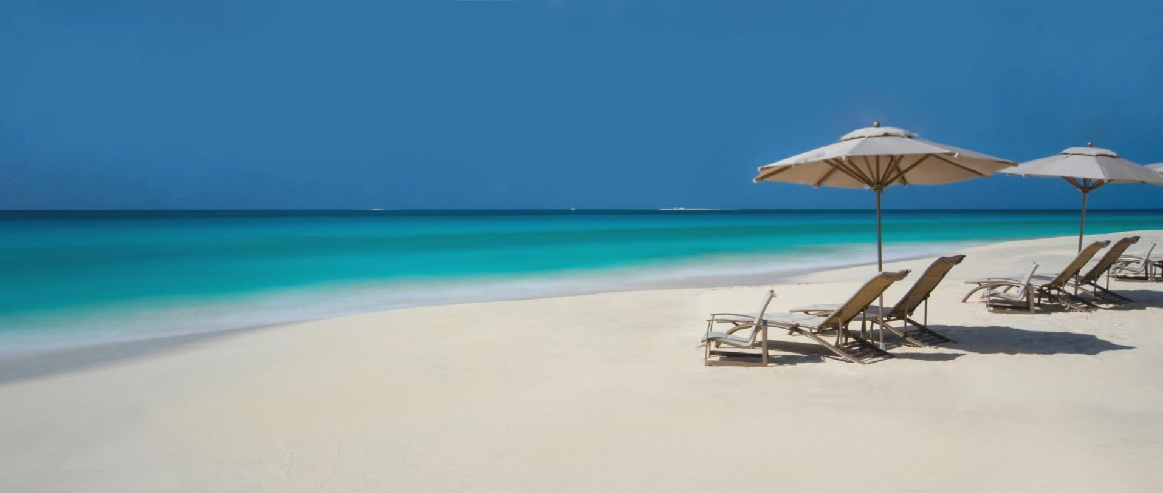

Slide 2
Welcome to Island Paradise
QUINTESSENCE HOTEL ANGUILLA

Slide 3
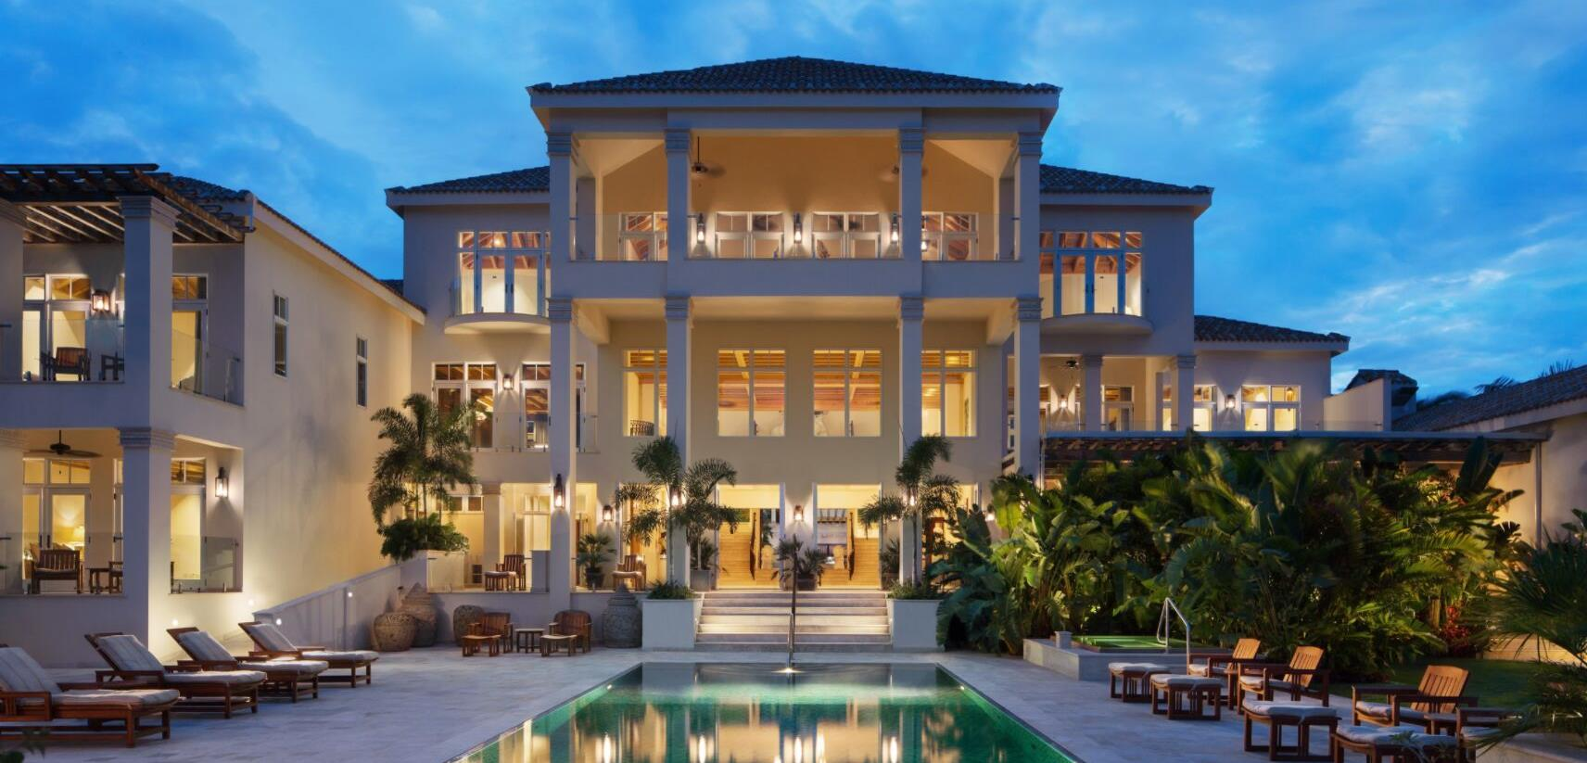
The Tropical Grand Mansion

Slide 4
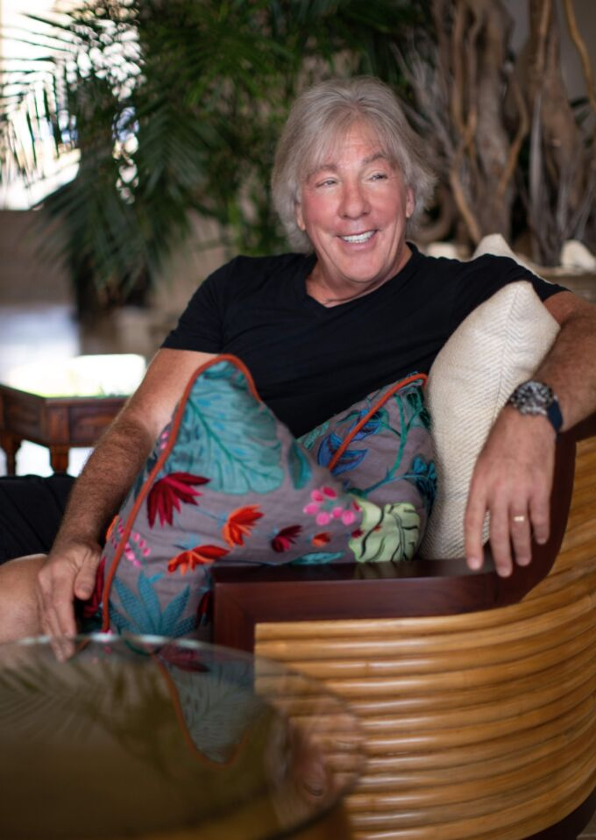
It took 10 years to perfect my vision. We are proud to offer Quintessence Hotel as an unparalleled destination for discerning guests who desire unrivaled luxury, privacy and personalized pampering. It is for these special guests that Quintessence was created.
Owner Geoffrey Fieger

Slide 5
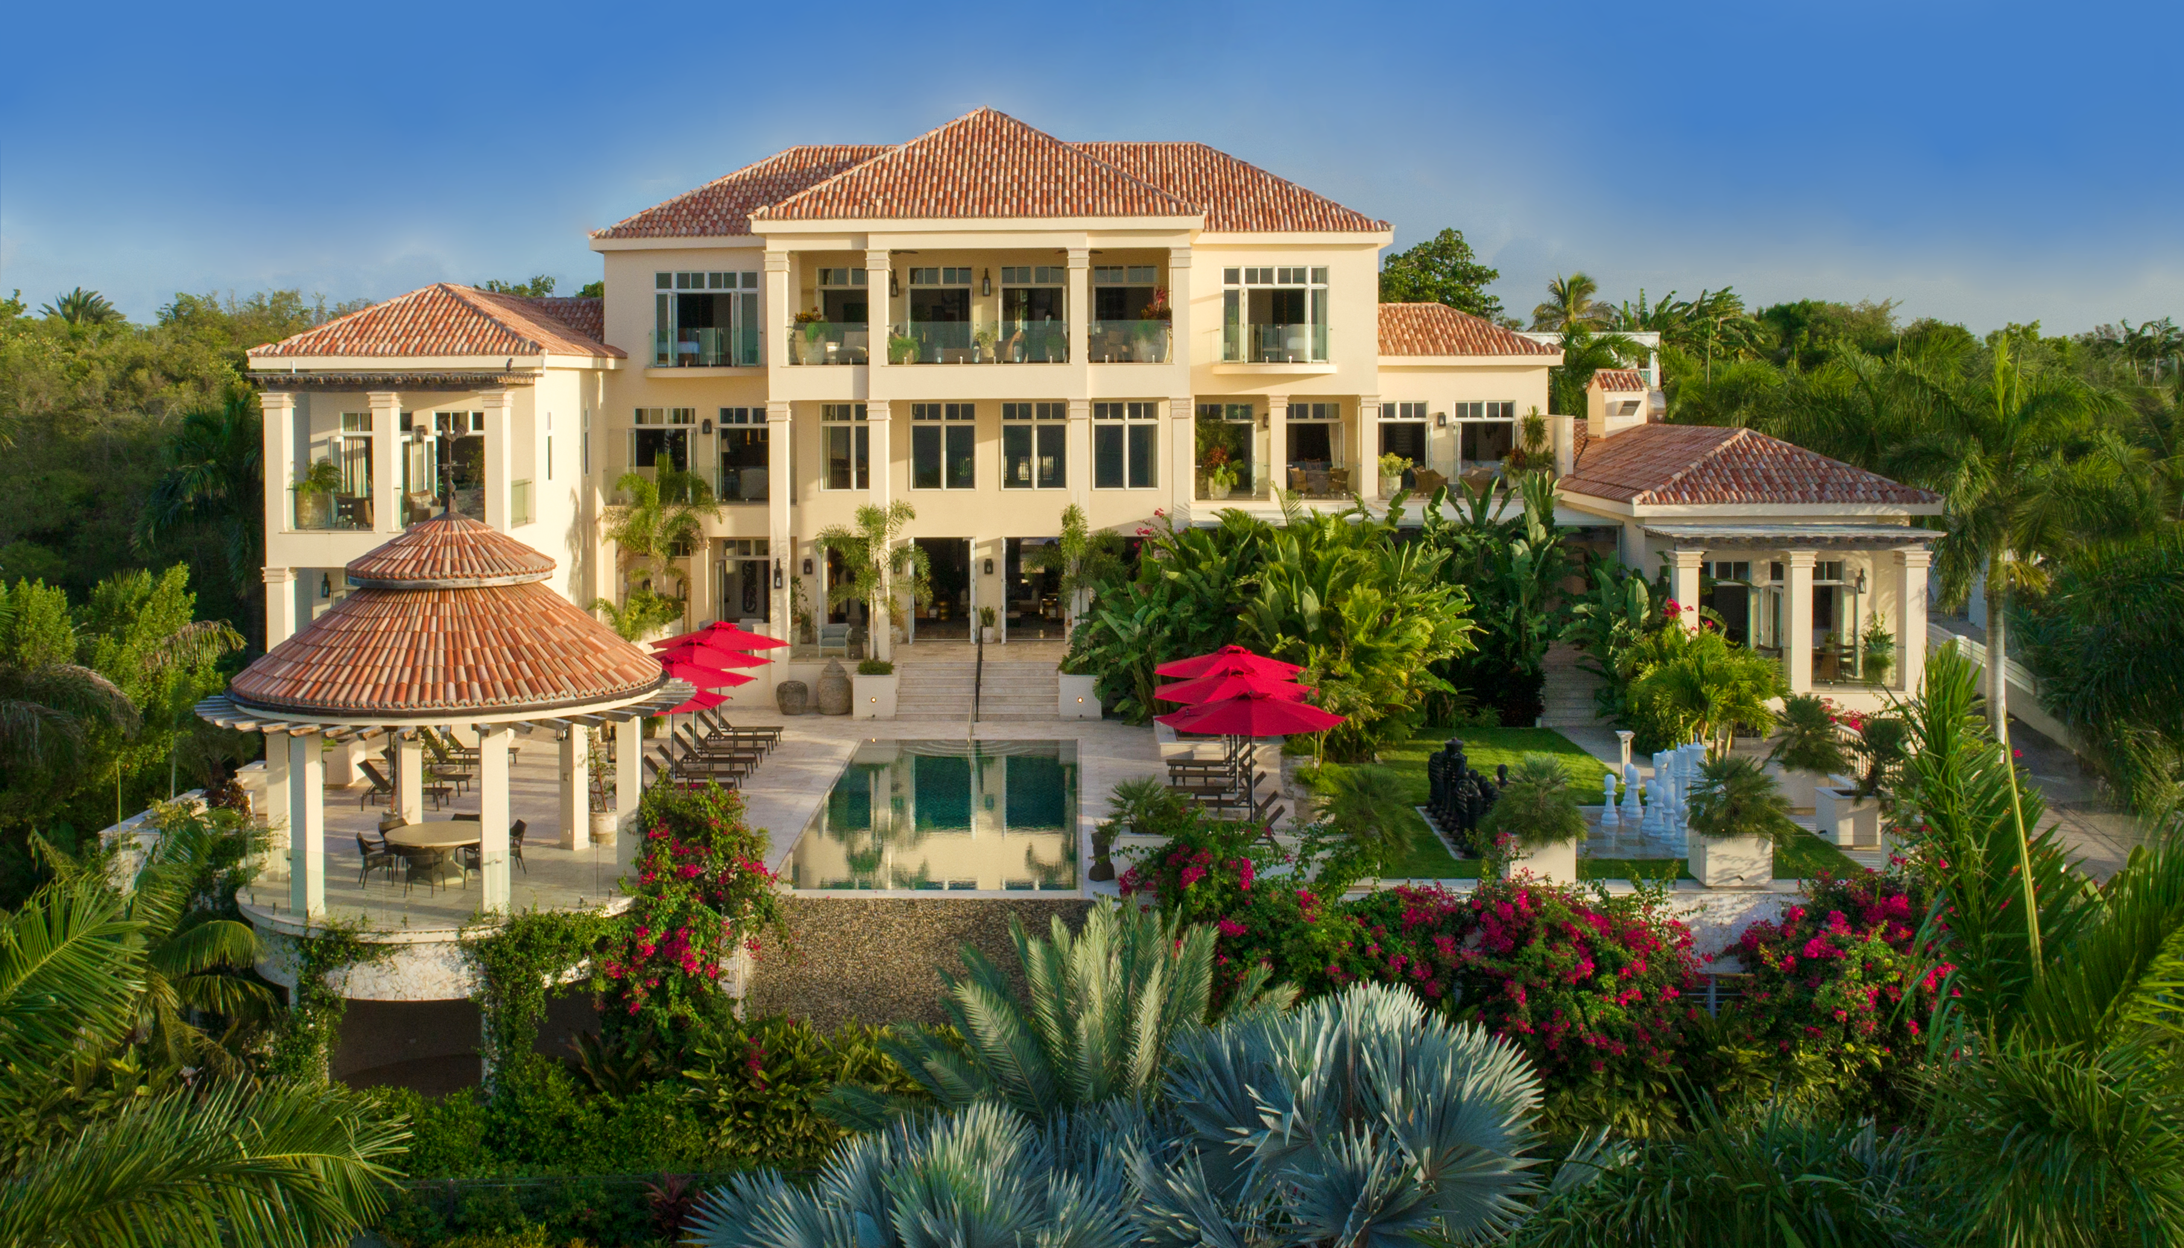

Slide 6
Grand Lobby

Slide 7
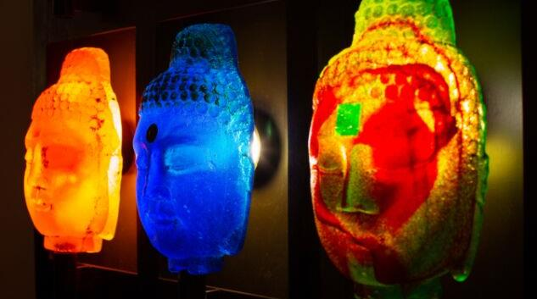
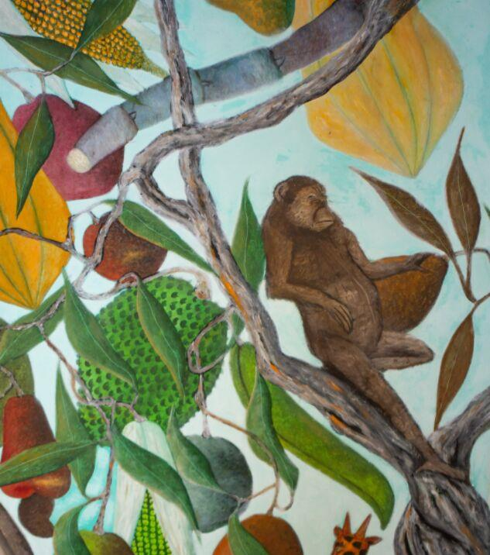
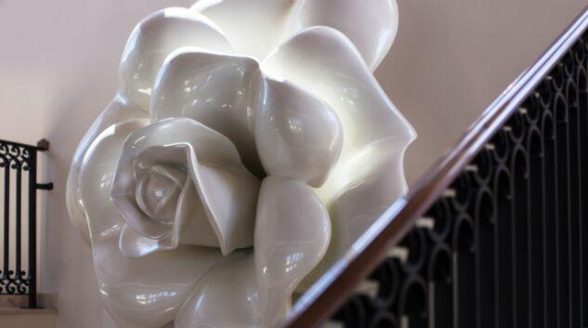
The Art of Quintessence

Slide 8
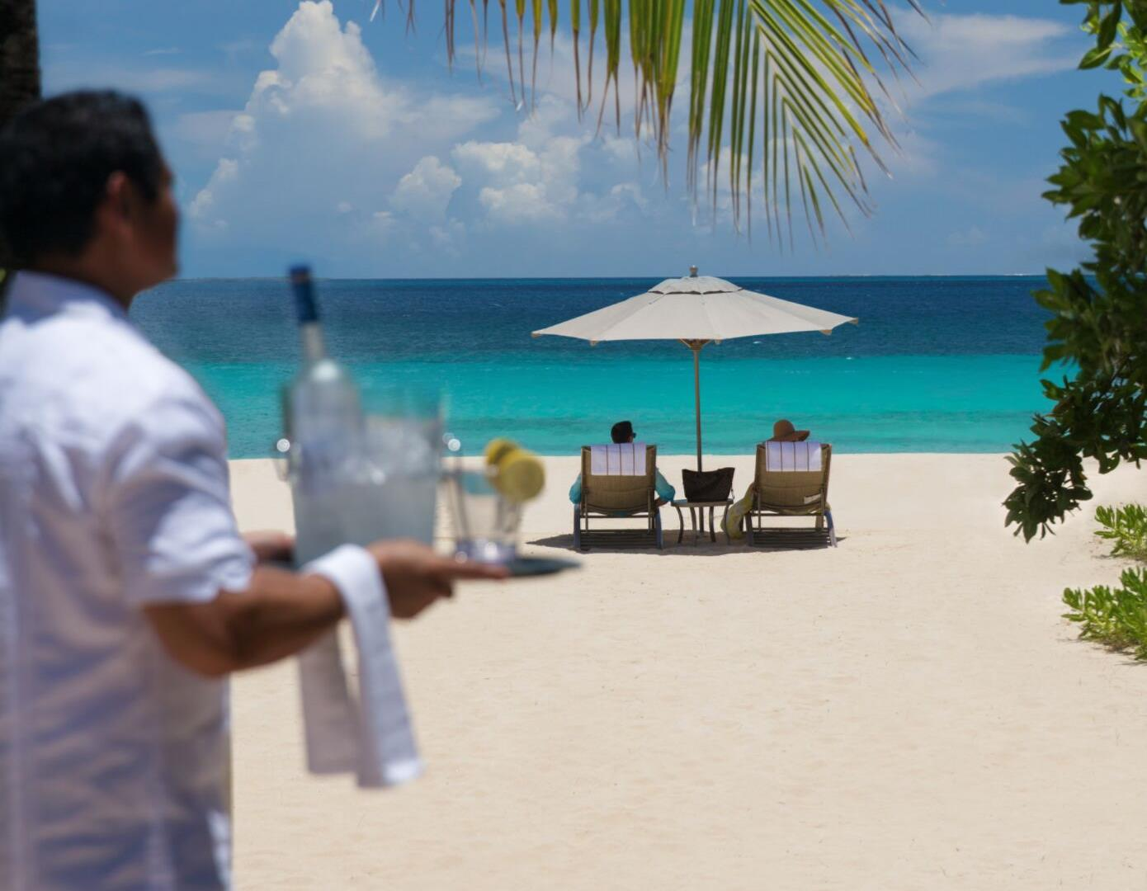
Private Beach with
24-Hour Butler Service

Slide 10
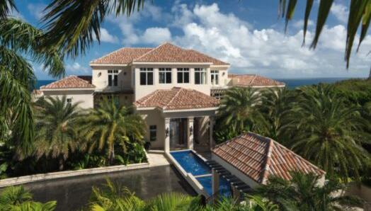
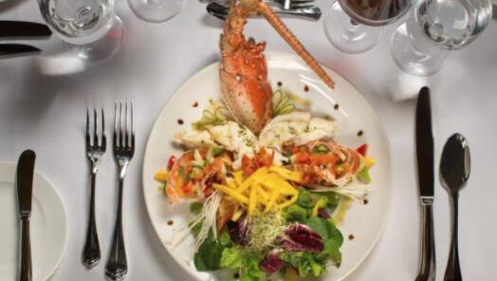
Q HOTEL ANGUILLA.COM
Quintessence Hotel
A Tropical Grand Mansion| Anguilla, British West Indies
HOTEL
SPA
RESTAURANT
Nine Unique Suites
Award Winning Cuisine
Wellness & Fitness

Slide 11
The Relais & Châteaux Commitments
To preserve the diversity of cuisines and hospitality in this world so that future generations can know and share in their richness
Share our passion for all that is good and beautiful in this world
To work together to create a more humane world
Forbes Travel Guide Star Rating
Only independent, global rating system for luxury hotels, restaurants and spas, since 1958.
Luxury is verified by anonymous professional inspectors
Rating is based on 900 objective criteria
Ultra Luxury
FOR THE
CHOOSEN FEW

Slide 12
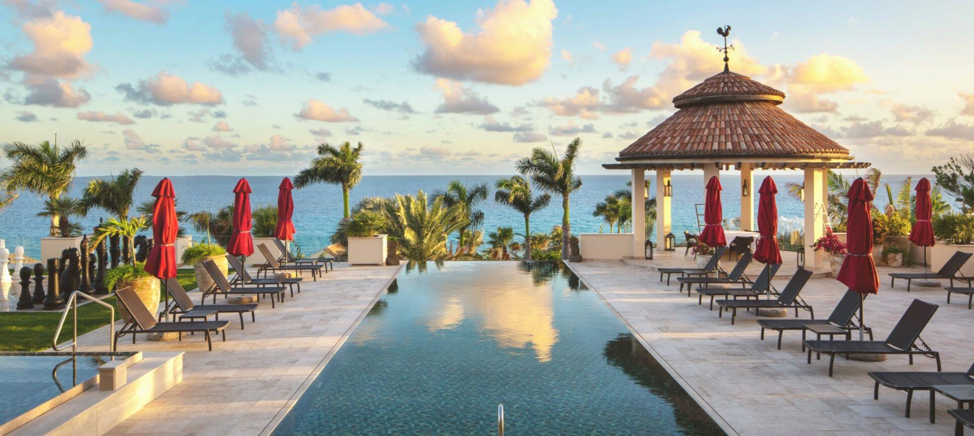
The Perfect Setting

Slide 13
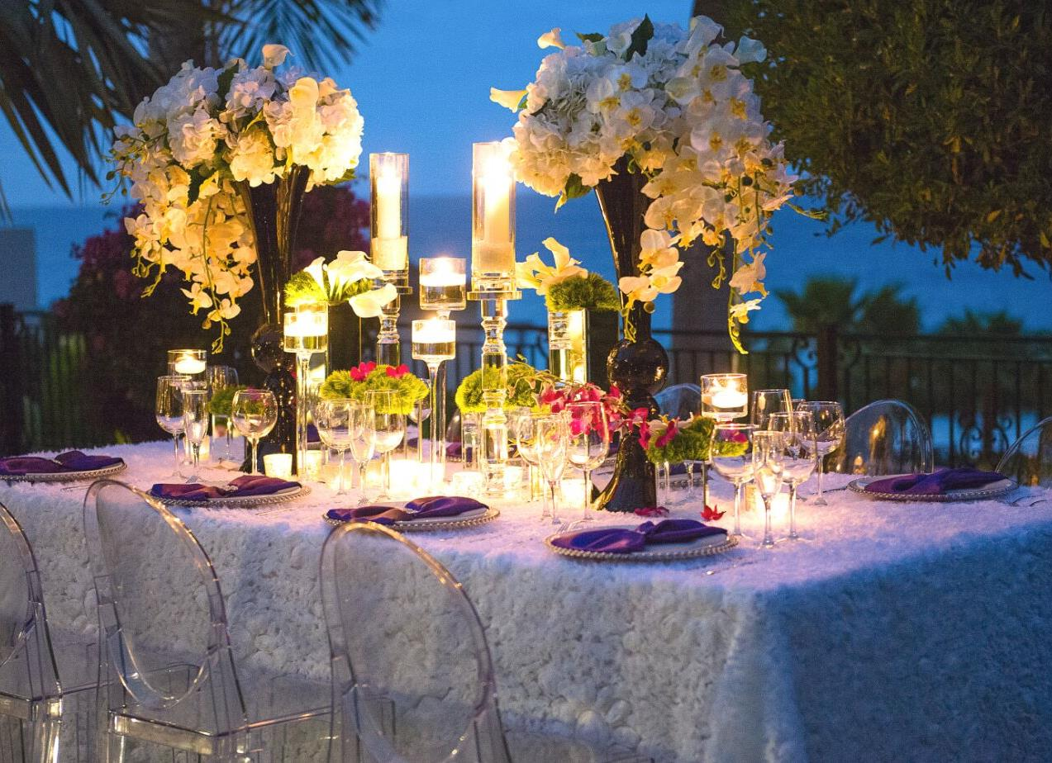
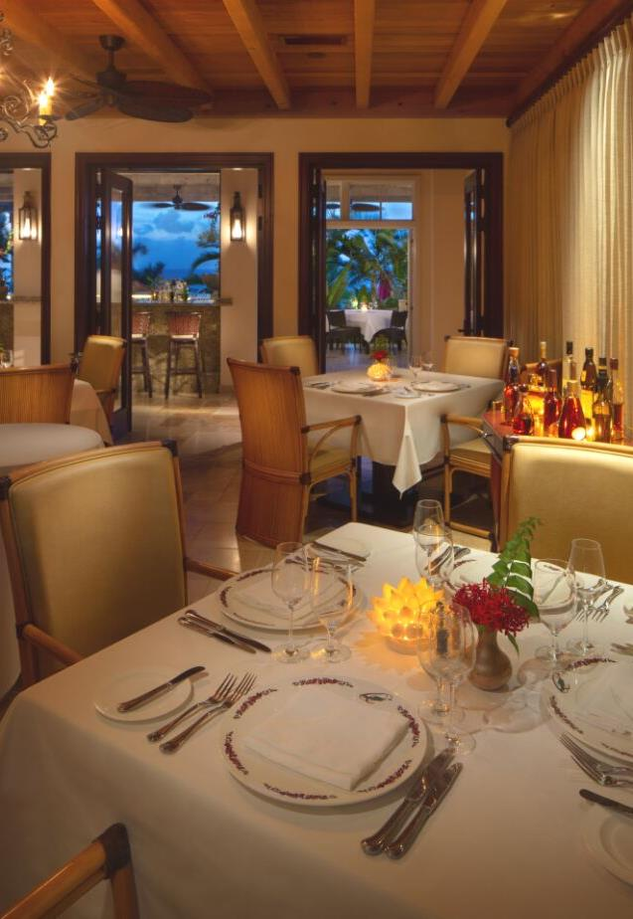
Epicurean Pleasures

Slide 14
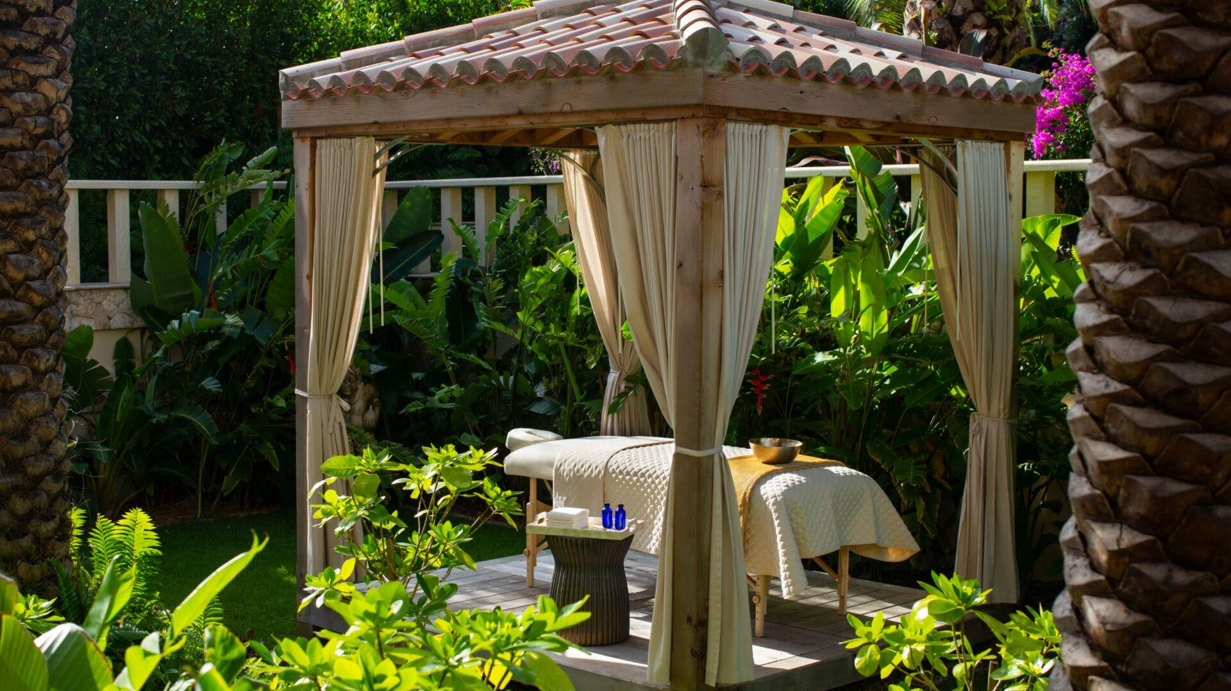
Relax &
Rejuvenate

Slide 15
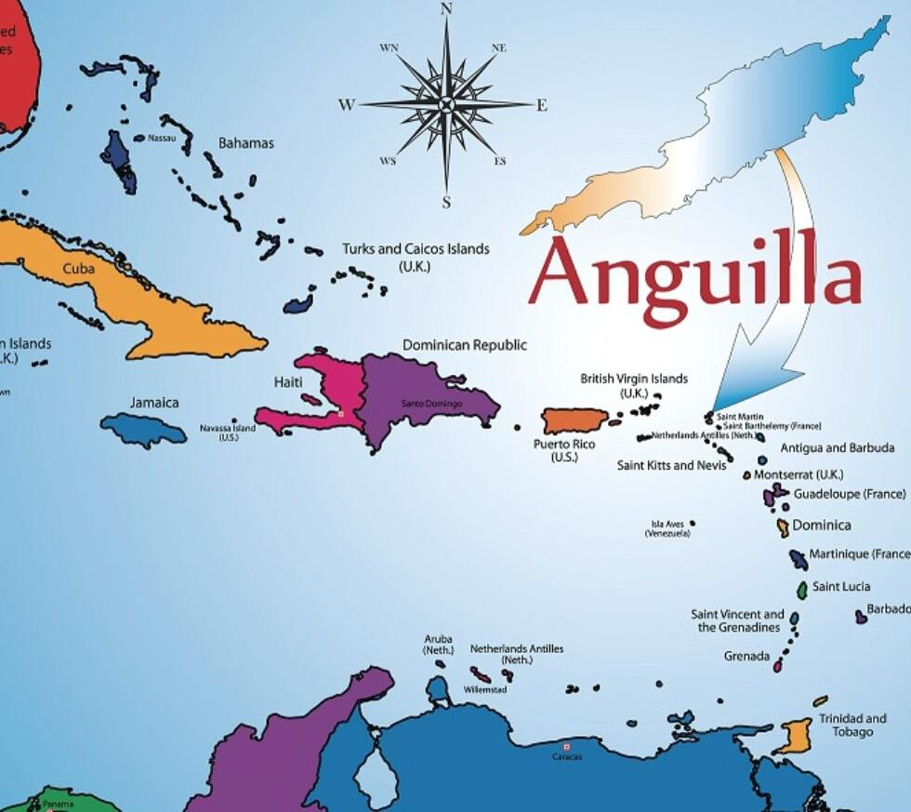
Where is Anguilla?
PRIVATE & EXCLUSIVE
In the heart of the Caribbean, Anguilla—a British overseas territory, is located east of Puerto Rico and the British Virgin Islands; and north of St. Maarten, St Kitts and Nevis. It is the most northerly of the Leeward Islands in the Lesser Antilles.
Most fly into St. Maarten (SXM) and take a 20-minute ferry to the island. Connecting flights are available from San Juan, Puerto Rico (SJU). All private flights can fly directly into Anguilla (AXA).

Slide 16
NINE UNIQUE SUITES
ULTRA LUXURY SERVICE & AMENITIES
24/7 Butler Service
Lush Tropical Gardens
Luxury Boutique
Media Room
Conference Room
Bluetooth Sound System
Wireless Internet
Five-Star Restaurant
Two Bars
Award-Winning Wine Cellar
Hästens Beds with Frette linens
Amenities by Gilchrist & Soames
Spa Services
Infinity Pool & Jacuzzi
Outdoor Yoga Pavilion
Fitness Center
Sauna/Steam Room
Billiard Room
Tennis Court
Life-Sized Chess Board

Slide 17
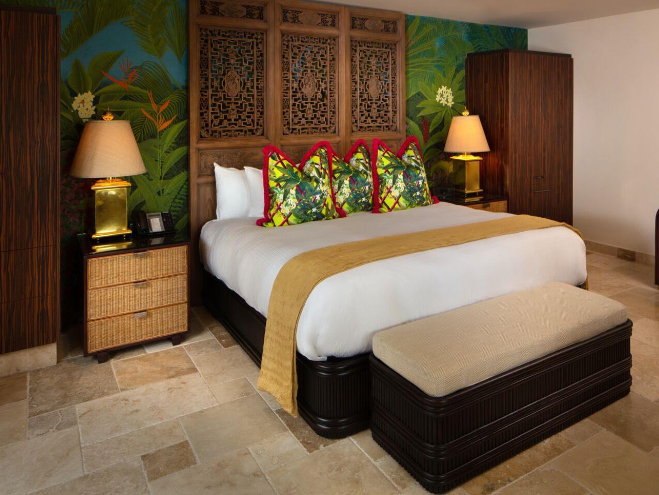
Q HOTEL ANGUILLA.COM
RATES
WINTER
Jan 06 – Apr 15
$1250
SPRING
Apr 16 – July 31
$650
FALL
Nov 02 – Dec 15
$750
FESTIVE
Dec 16 – Jan 05
$1750
Garden Suites
MEADS BAY
SEA GRAPE
LONG BAY

Slide 18
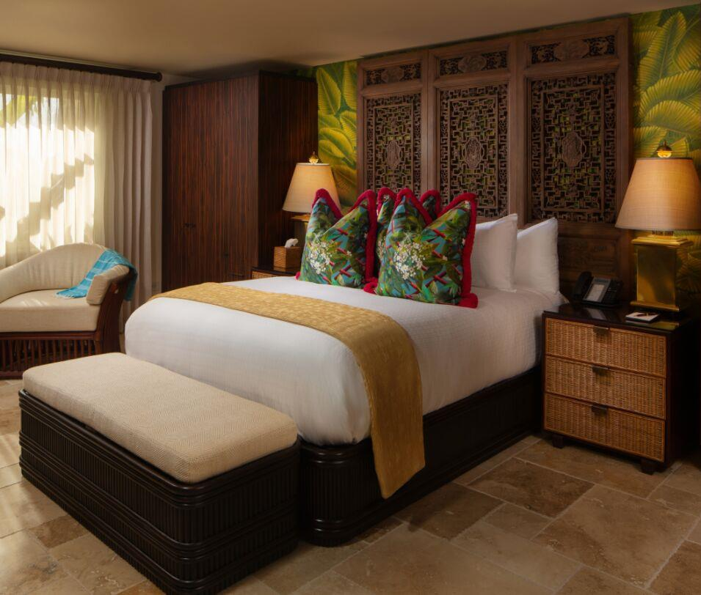
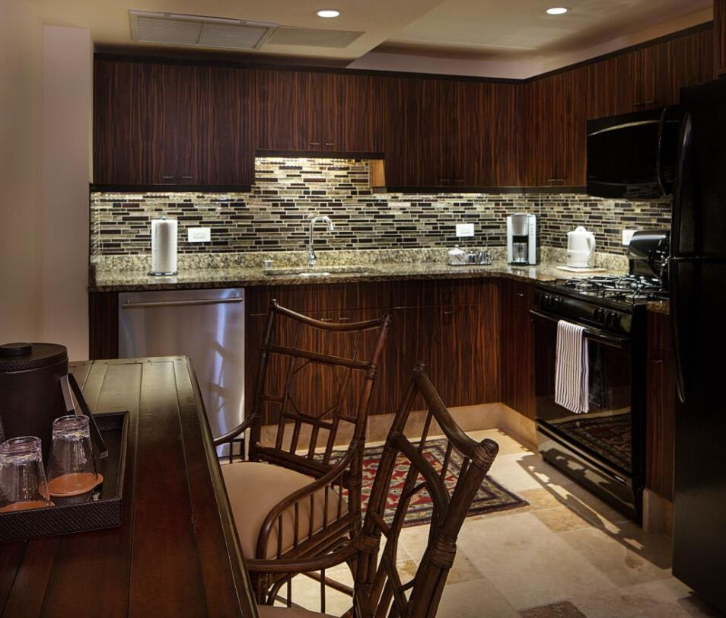
Meads Bay Garden Suite

Slide 19
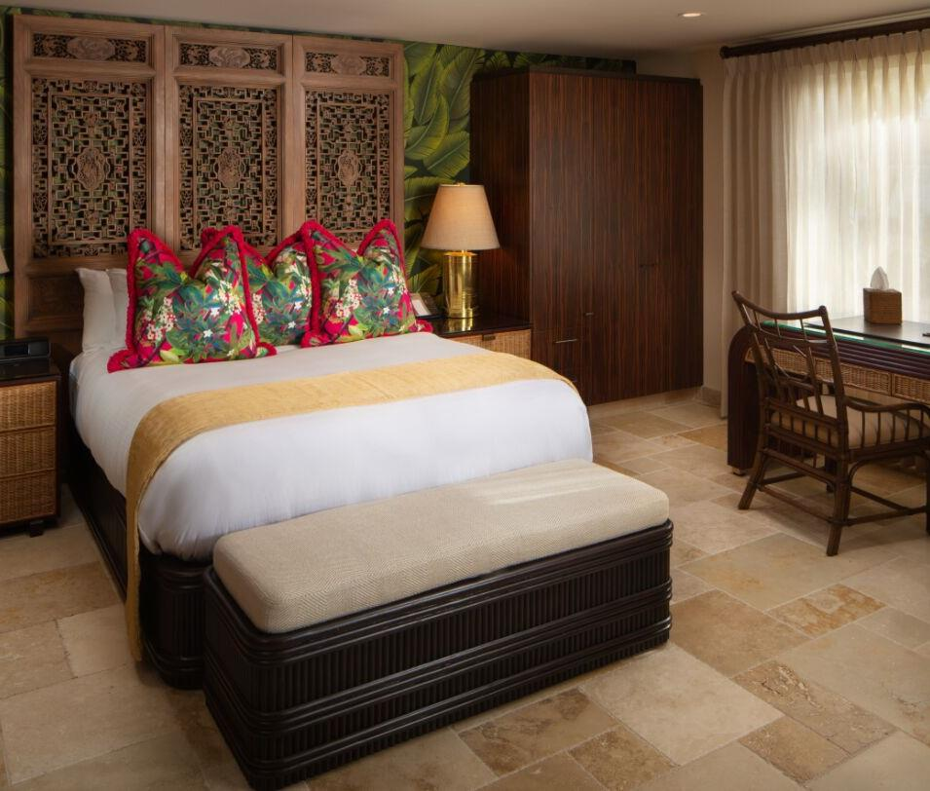
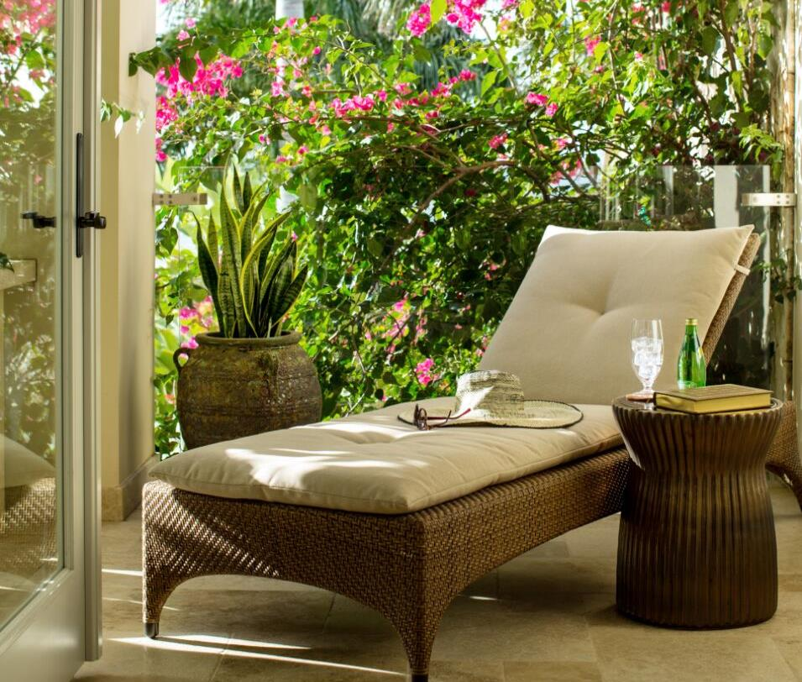
Sea Grape Garden Suite

Slide 20
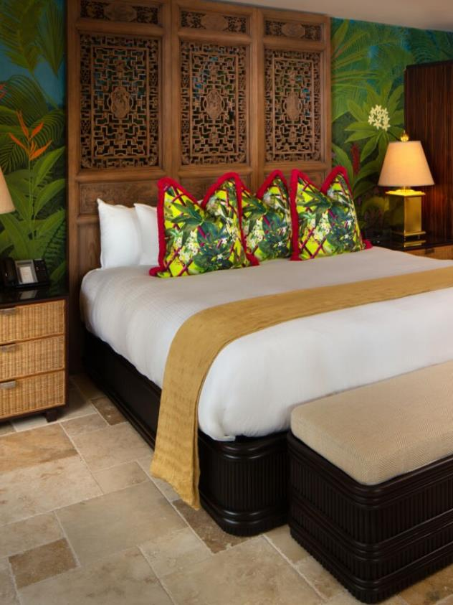
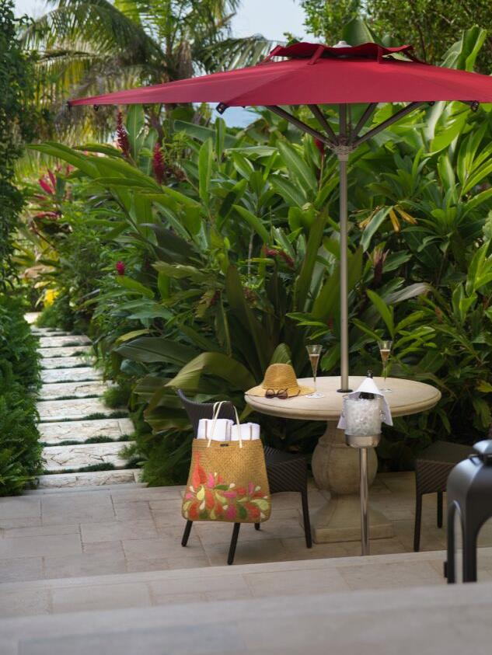
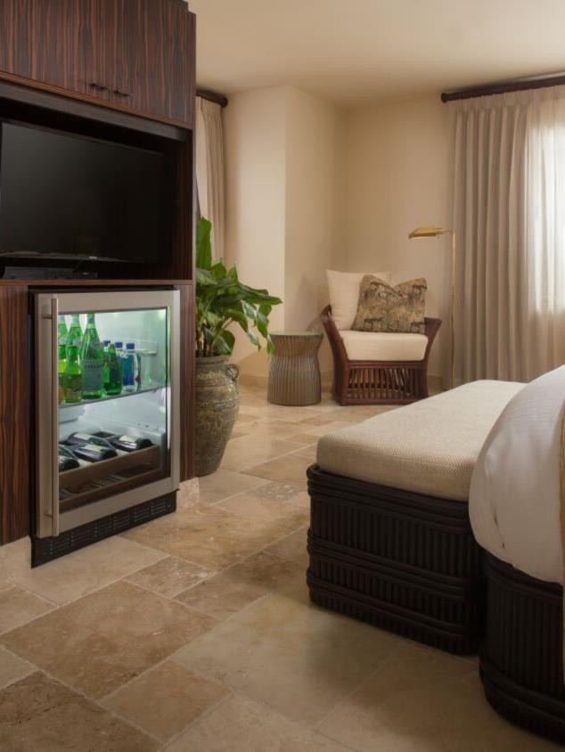
Long Bay Garden Suite

Slide 21
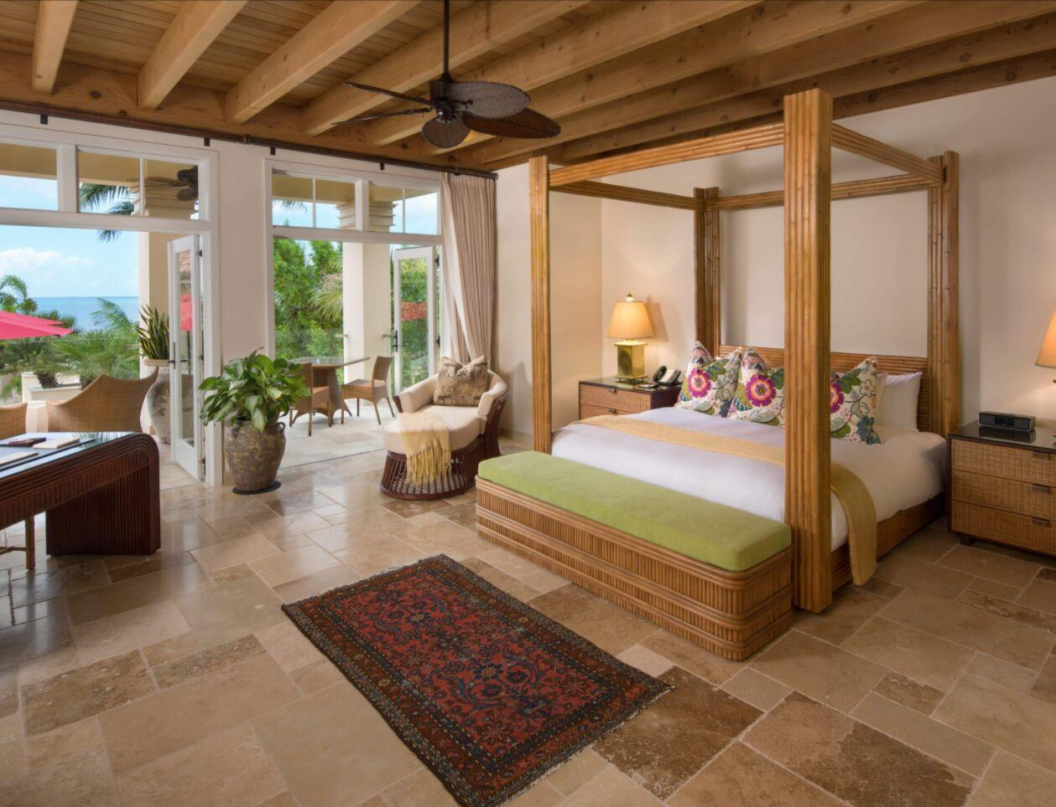
Q HOTEL ANGUILLA.COM
RATES
WINTER
Jan 06 – Apr 15
$2000
SPRING
Apr 16 – July 31
$1100
FALL
Nov 02 – Dec 15
$1250
FESTIVE
Dec 16 – Jan 05
$2500
Luxury Suites
PROSPER
BONHOMME
BRESIL

Slide 22
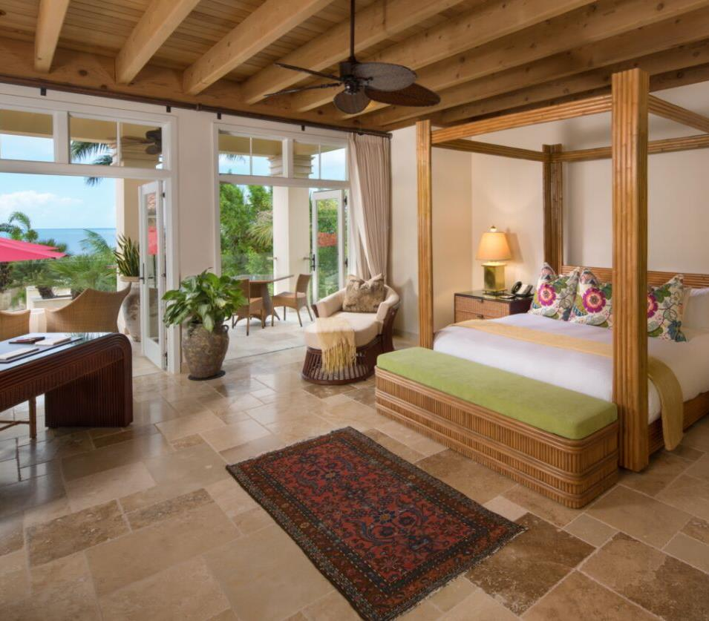
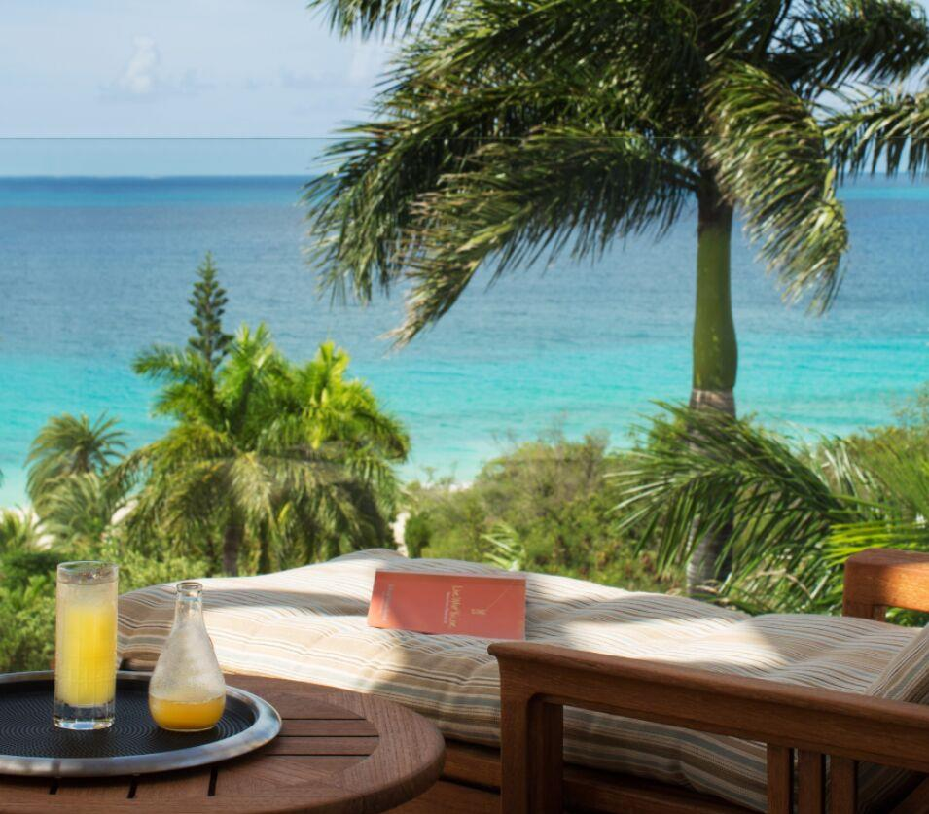
Prosper Luxury Suite

Slide 23
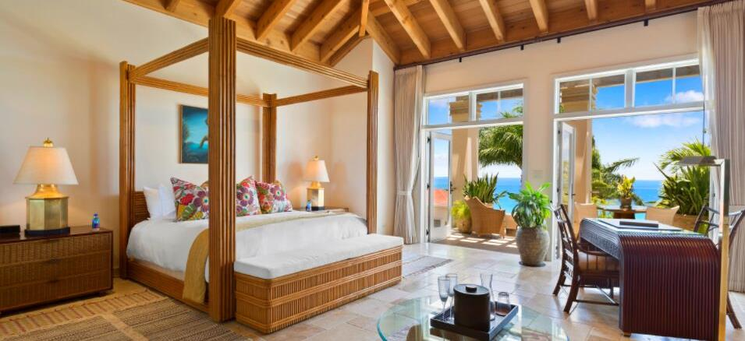
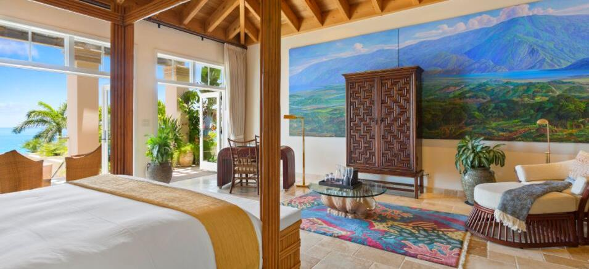
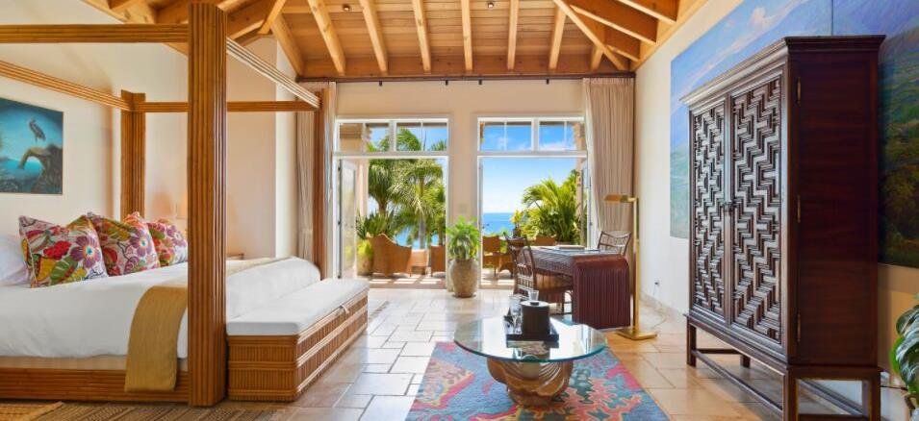
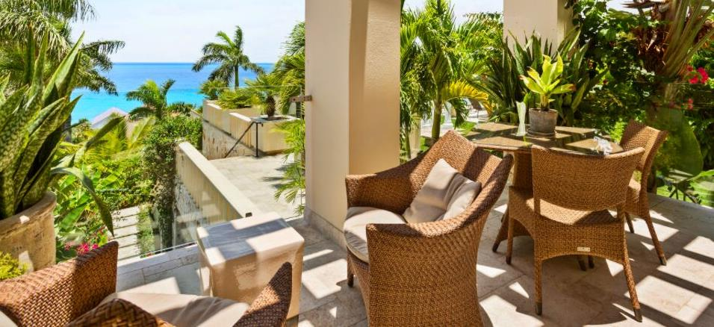
Bonhomme Luxury Suite

Slide 24
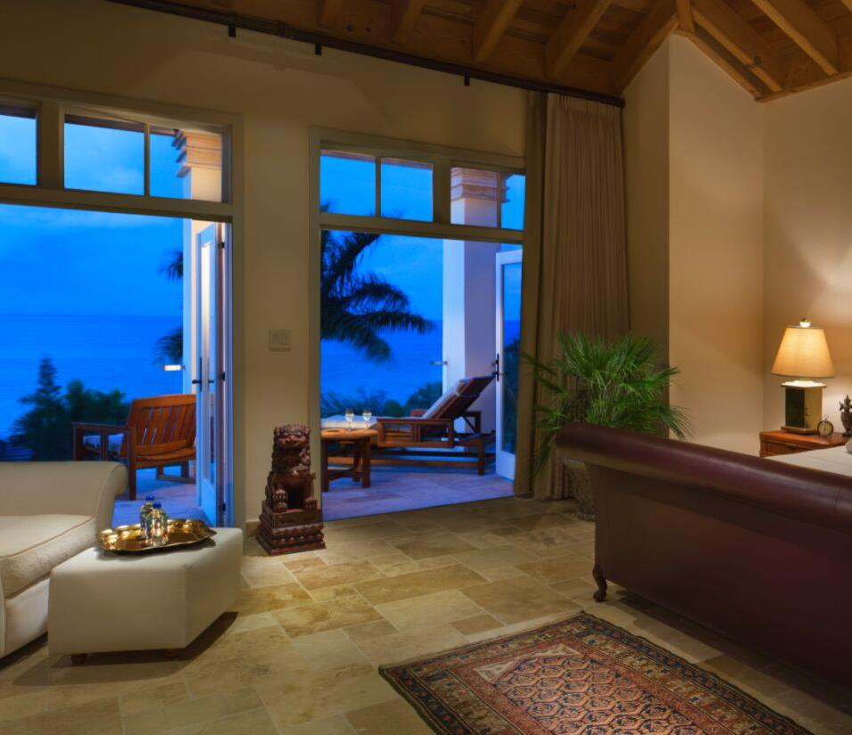
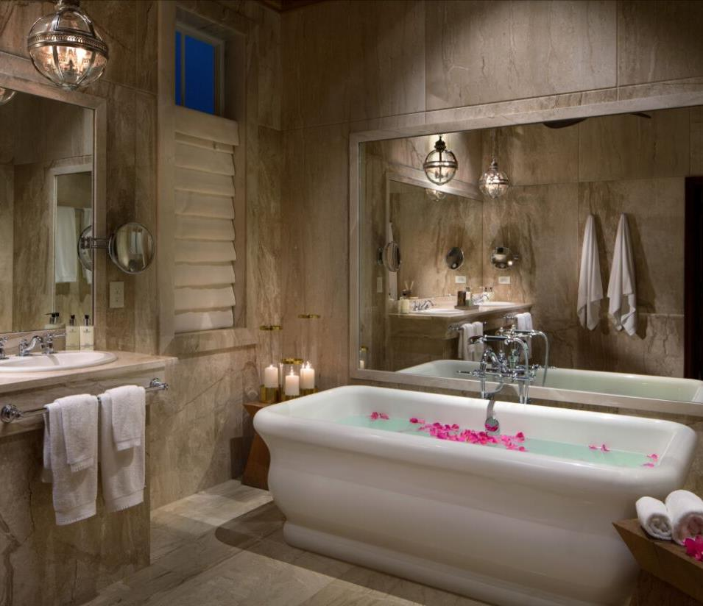
Bresil Luxury Suite

Slide 25
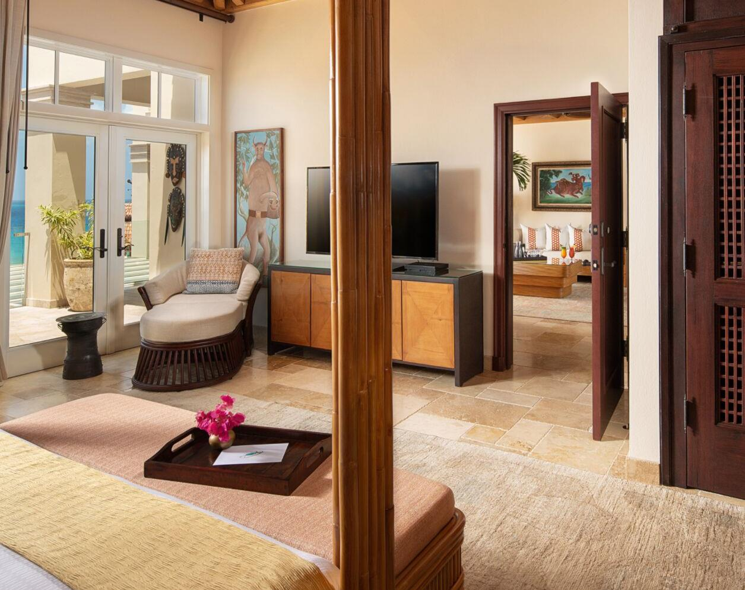
Q HOTEL ANGUILLA.COM
RATES
Luxury
Premium Suite
WINTER
Jan 06 – Apr 15
$3000
SPRING
Apr 16 – July 31
$1500
FALL
Nov 02 – Dec 15
$2500
FESTIVE
Dec 16 – Jan 05
$4500
BLAIN

Slide 26
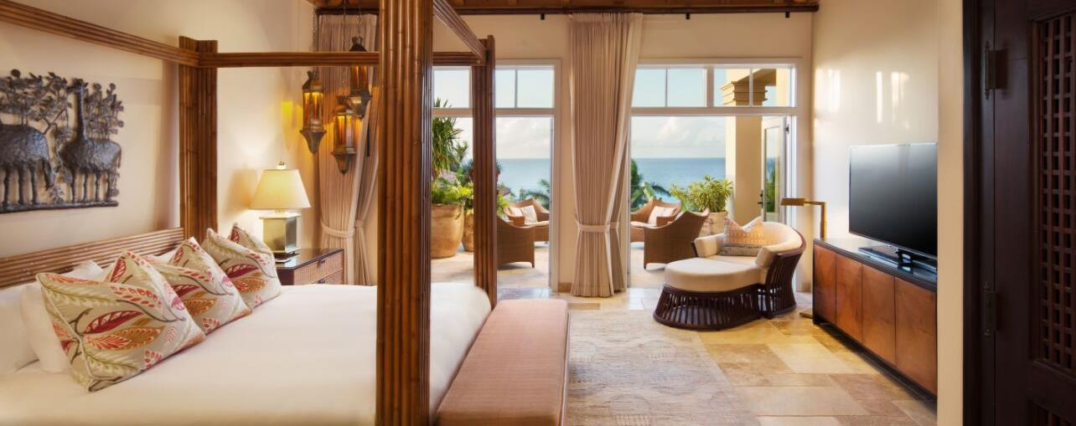
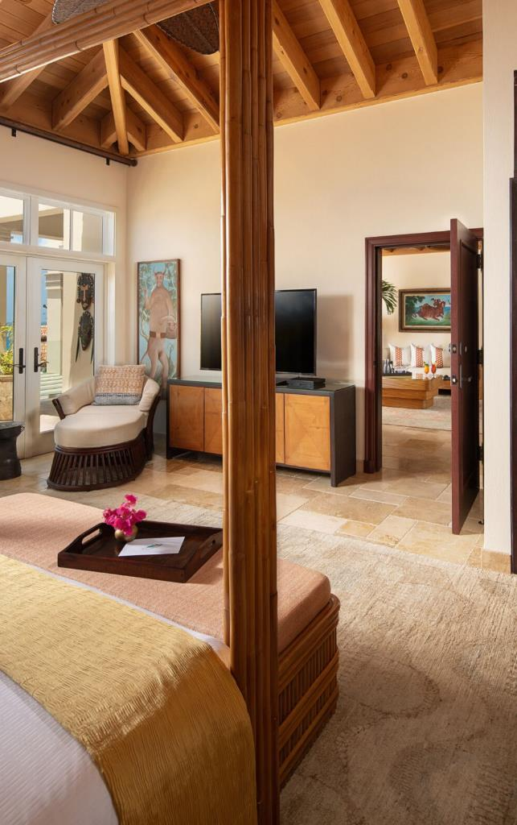
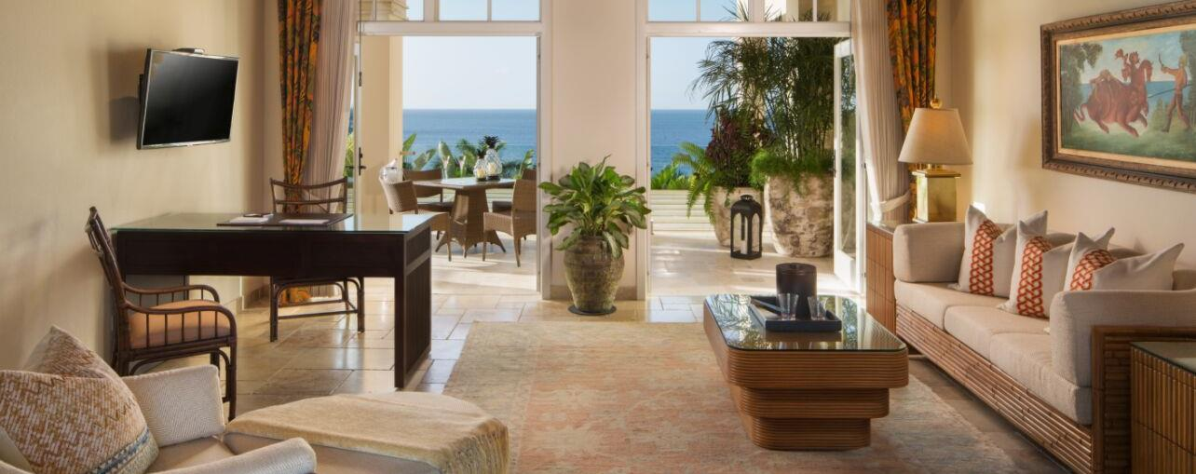
Blain Luxury Premium Suite

Slide 27
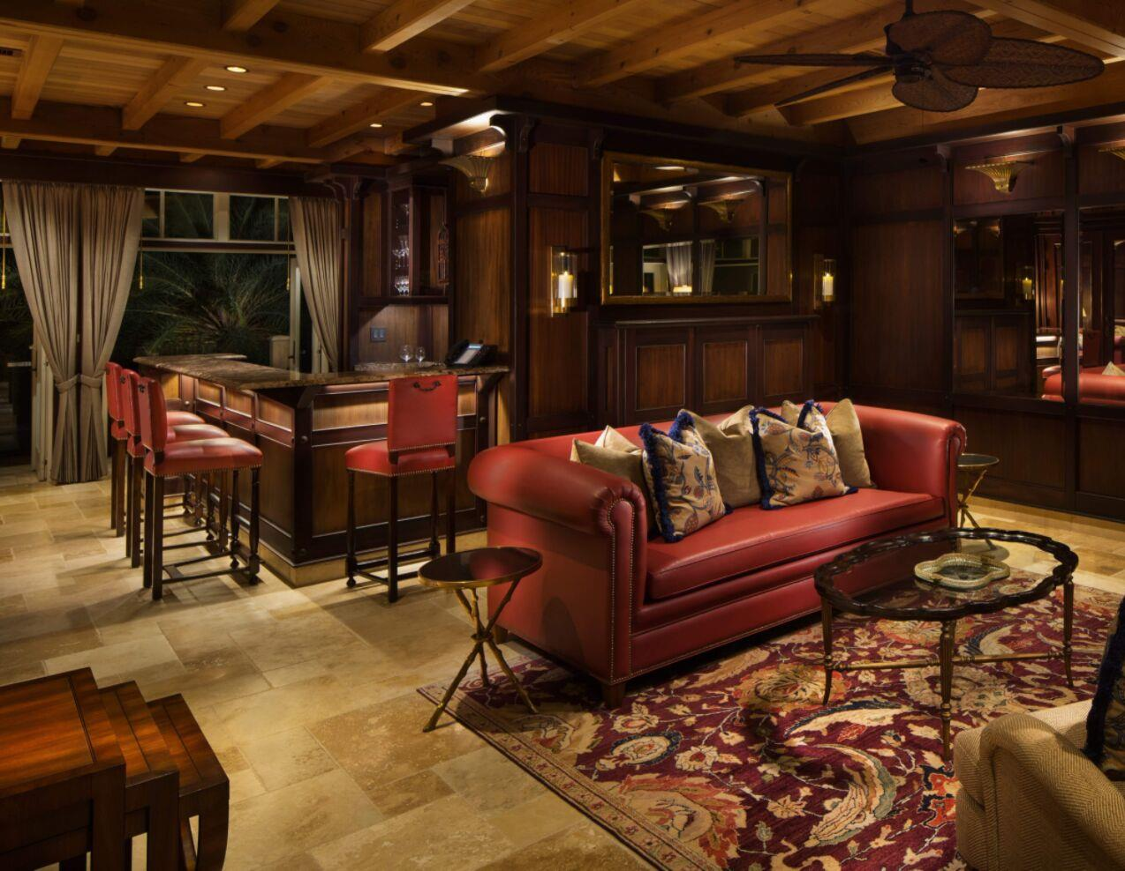
Q HOTEL ANGUILLA.COM
RATES
WINTER
Jan 06 – Apr 15
$4500
SPRING
Apr 16 – July 31
$2500
FALL
Nov 02 – Dec 15
$3500
FESTIVE
Dec 16 – Jan 05
$6000
Grand
Suite
BRESIL POLO

Slide 28
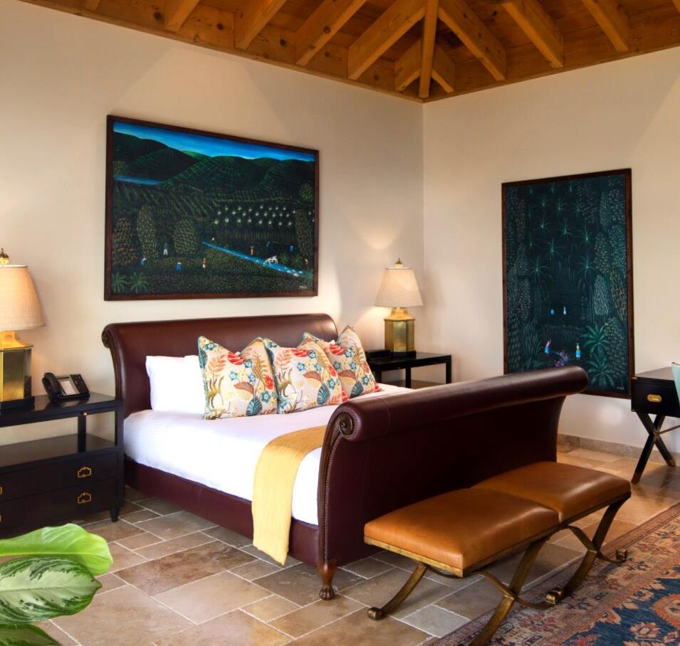
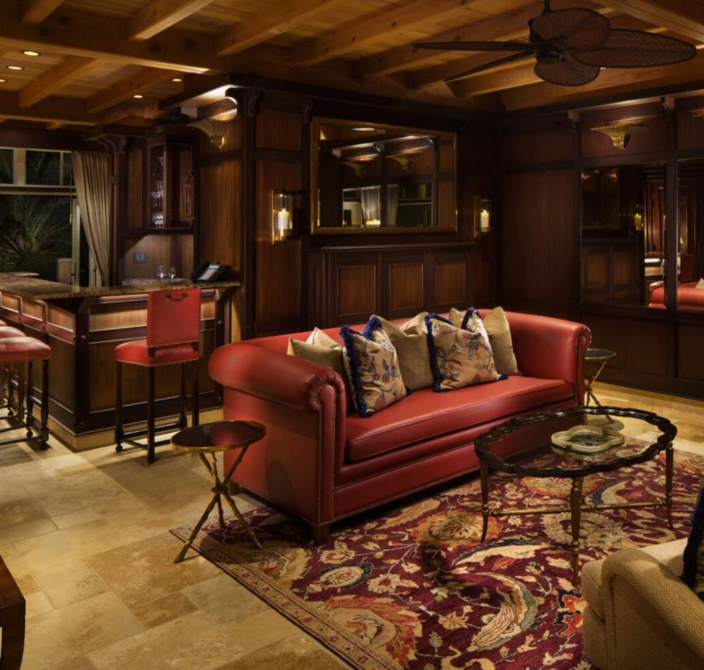
Bresil Polo Grand Suite

Slide 29
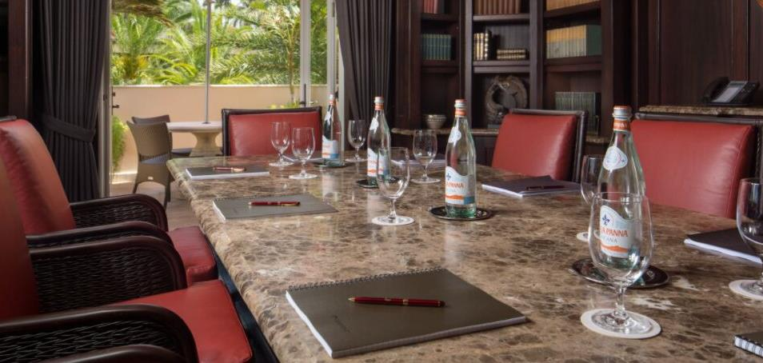
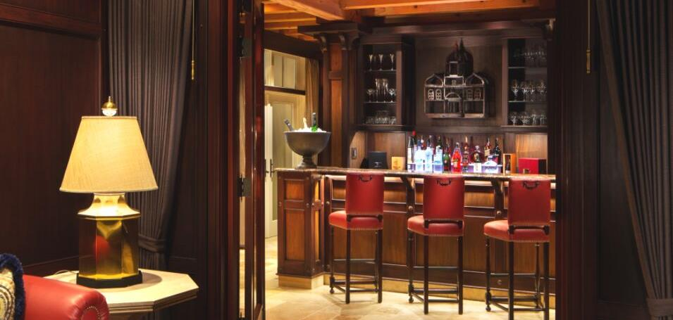
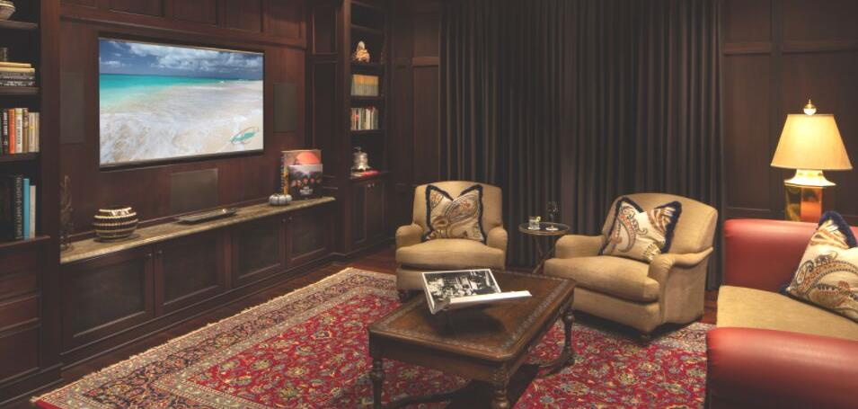
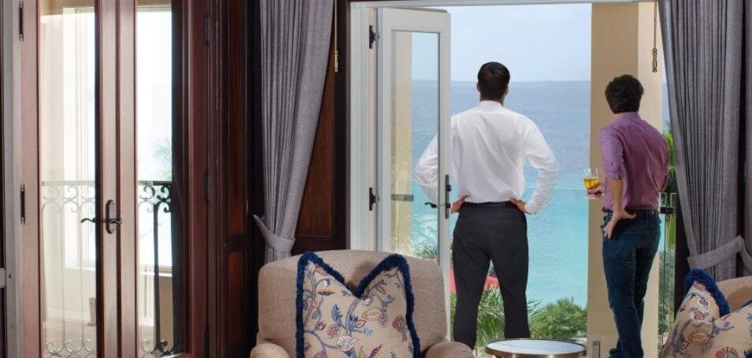
Polo Lounge, Media & Conference

Slide 30
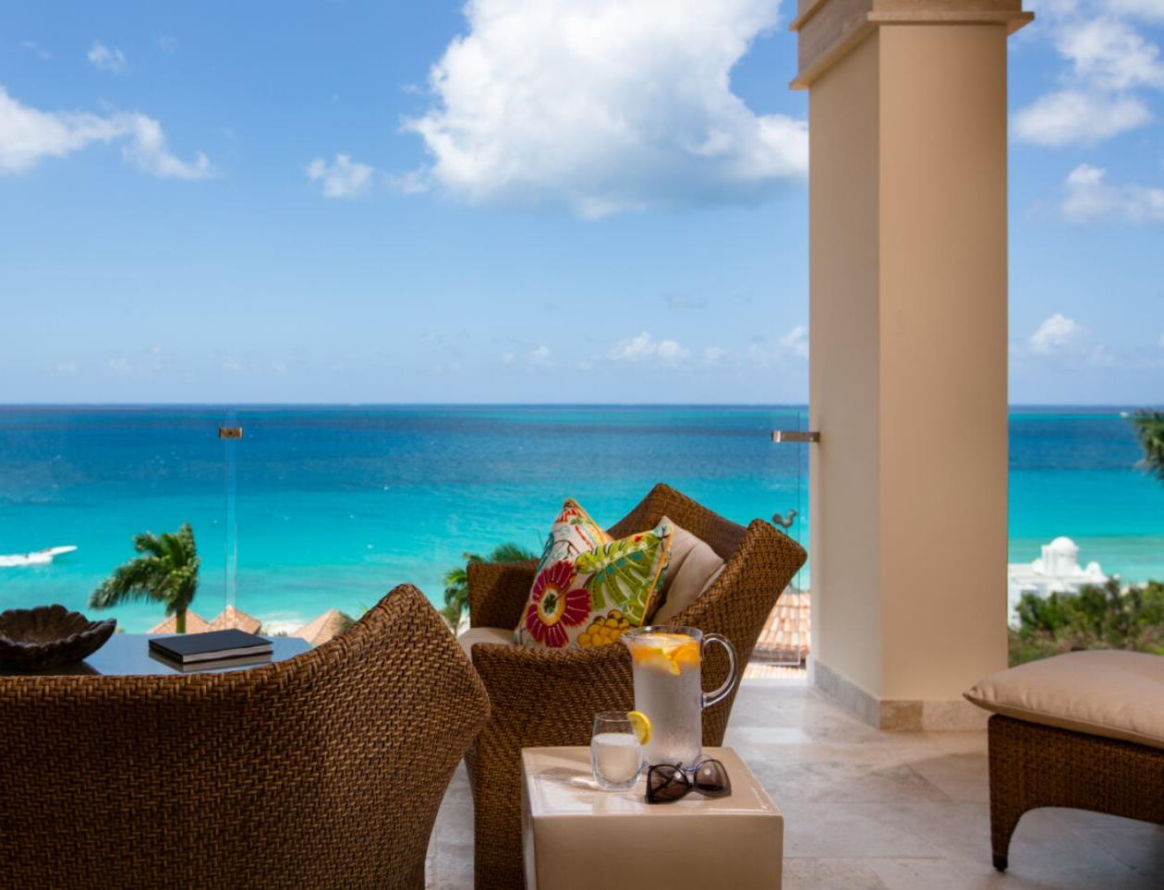
Q HOTEL ANGUILLA.COM
RATES
WINTER
Jan 06 – Apr 15
$7500
SPRING
Apr 16 – July 31
$3500
FALL
Nov 02 – Dec 15
$4000
FESTIVE
Dec 16 – Jan 05
$12,500
Penthouse
JOSEPH

Slide 31
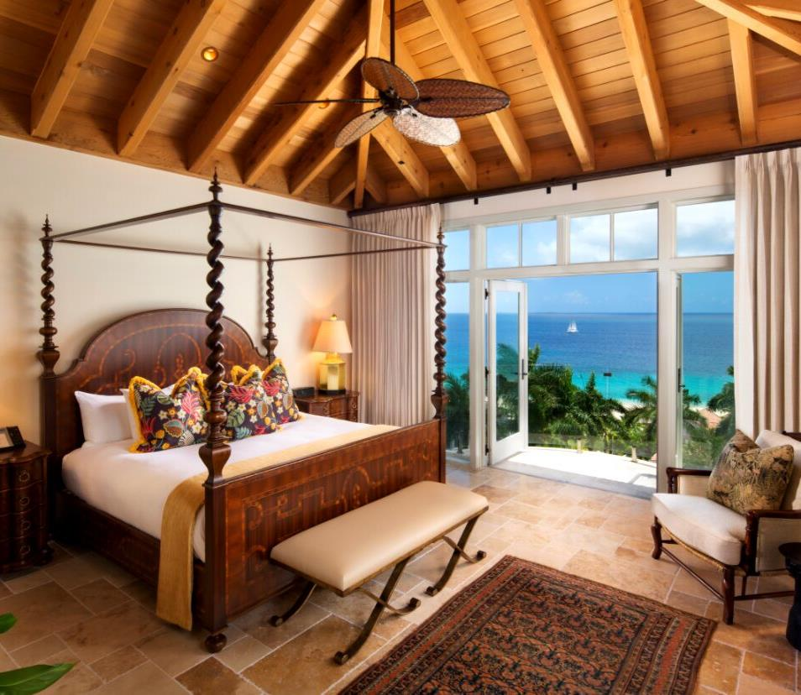
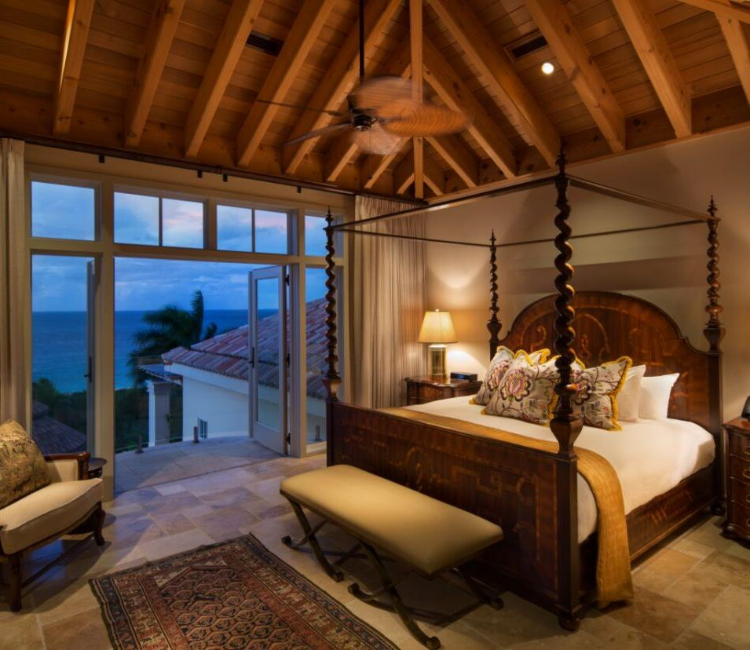
Joseph Penthouse

Slide 32
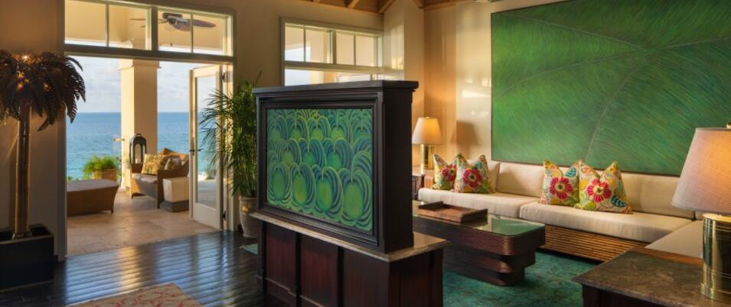
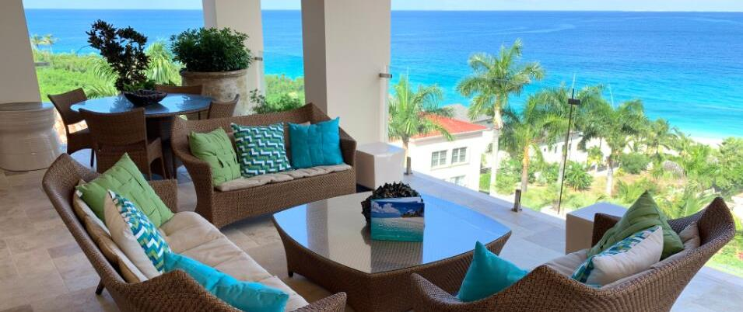
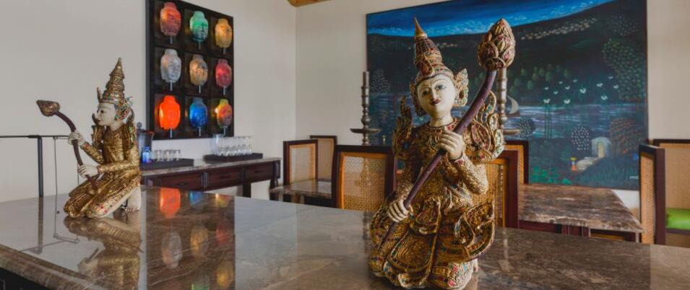
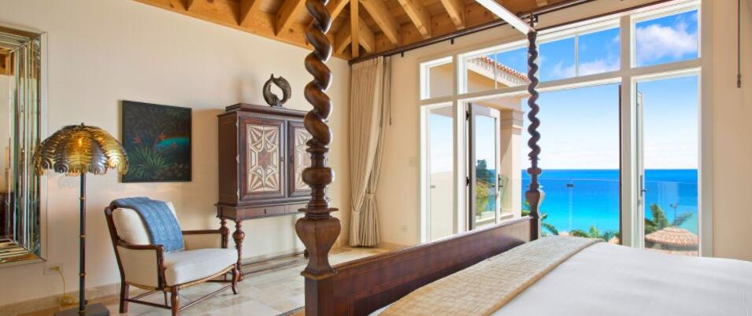
Joseph Penthouse Living, Dining & Terrace

Slide 33
JULIANS - A Tropical French Bistro
AWARD WINNING FIVE-STAR CUISINE

Slide 34
JULIANS - A Tropical French Bistro
AWARD WINNING FIVE-STAR CUISINE
Grand Gazebo

Slide 36
JULIANS - A Tropical French Bistro
AWARD WINNING FIVE-STAR CUISINE

Slide 37
AIDAN SPA
WE BELIEVE WELLNESS IS A LIFESTYLE

Slide 38
Q HOTEL ANGUILLA.COM
2019 - 2020
Rate
Card

Slide 40
Q HOTEL ANGUILLA.COM
RESERVE NOW
264.498.8106 reservations@qhotelanguilla.com

Slide 41
Q HOTEL ANGUILLA.COM

Slide 42
Q HOTEL ANGUILLA.COM

